Slide 1


What are the likely factors for people to want to move out of San Francisco?

Slide 2
Research Questions:
Which age group, ethnicity, education level, and household income are likely to move out of San Francisco comparing renters and homeowners?
How long have these candidates been living in San Francisco?
Which zip code within San Francisco has the highest interest to move out? And are the houses within these zip codes the costliest?
How do single family medium price homes in San Francisco compare with other cities such as Sacramento, Los Angeles, Seattle, Portland, and San Diego?

Slide 3
Data Source:
http://sfgov.org/citysurvey/file/95
https://www.zillow.com/research/data/
https://maps.googleapis.com/maps/api/geocode/json

Slide 4
Selection Criteria:
Data is restricted to San Francisco with the exception of comparison with other cities.
Data focuses on responses provided in a 2017 survey collected by City and County of San Francisco taken every other year.
Analysis is on respondents most likely to move out of San Francisco.

Slide 5
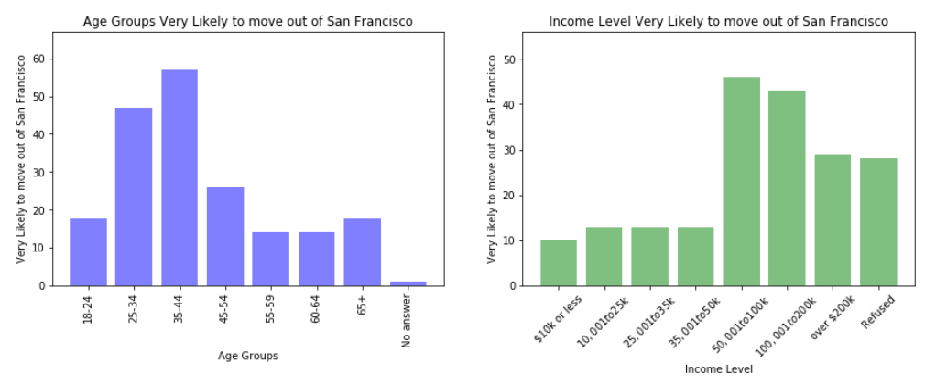
Age Group vs Income Level
Based on the charts, the age group most likely to move out of San Francisco are between ages 25 and 44 and income level between $50K to $200K. It is likely that the age group has more flexibility to be mobile with the level of income also playing a factor.

Slide 6
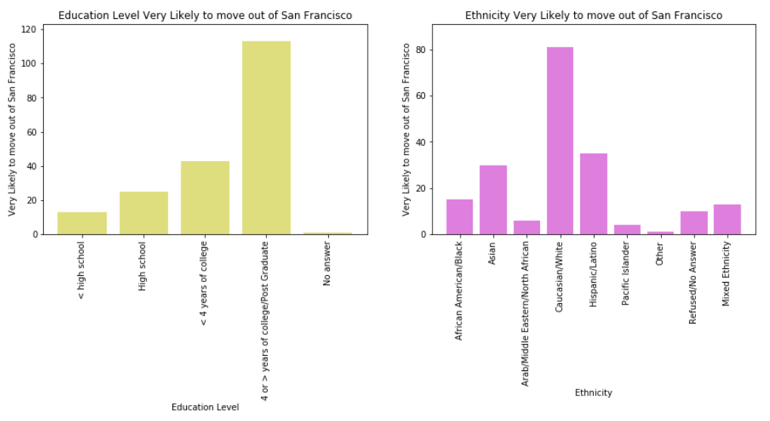
Education Level Ethnicity
Respondents with 4 or more years of college/post graduate are most likely to move out of San Francisco followed by ones who have less than 4 years of college.
Caucasian/White are the most likely group to move out of San Francisco followed by the Hispanic/Latino and Asian communities.

Slide 7
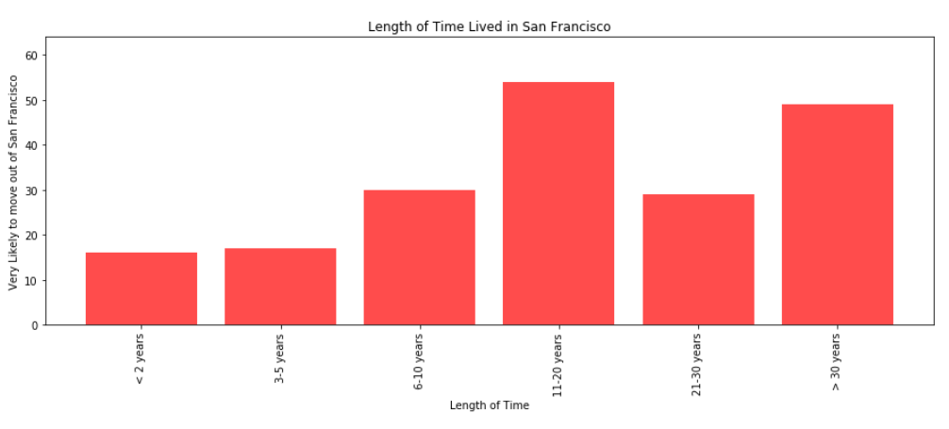
The two groups that are likely to move out of San Francisco are ones who lived in San Francisco between 11-20 years and more than 30 years. A good chance that these long timers want to move out of San Francisco is due to affordability of living in this area.

Slide 8
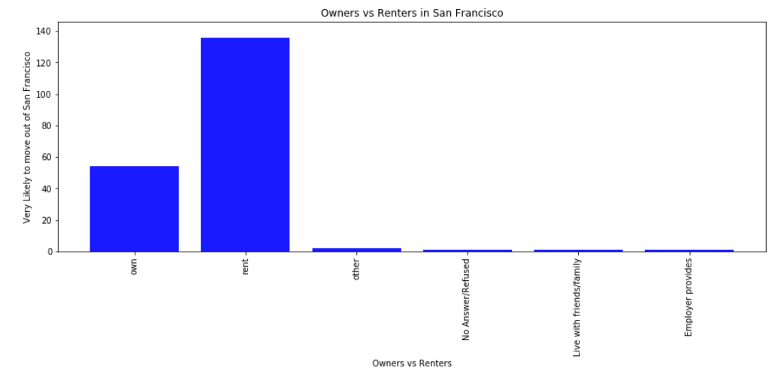
Majority of the survey respondents are either owners or renters of the place they live. There is 2.5% more renters than owners based on the number of survey responses taken in 2017.

Slide 9
Observations:
Of the 2100+ surveyed regarding transportation, only 92 respondents take Muni in 2017. This number is low to consider whether it is part of a deciding factor to move out of San Francisco.
Data set was already aggregated which limited the types of visualization to create. i.e. Linear regression chart was created but results did not provide any trend to conclude with any sort of insight.

